Slide 1
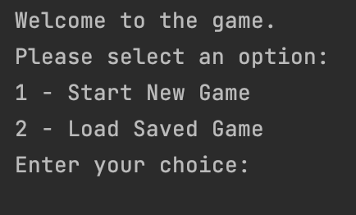
Adventure Game
Presented by:
Anil Shrestha
M22W7307

Slide 2
TABLE OF CONTENTS
Introduction
Game Architecture
Game Flow
Implementation Details
Technical Details
Installation and Setup
Future Improvements
Conclusion

Slide 3
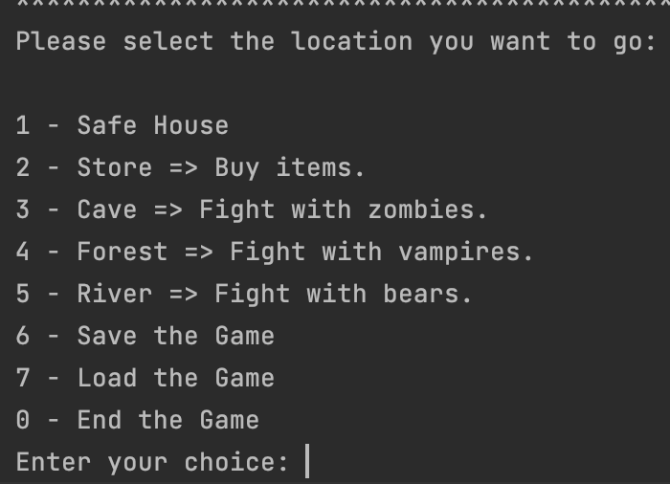
INTRODUCTION
Text-based Java Game that offers an interactive and engaging gaming experience.
Set off on adventure, explore different locations, and battle enemies.
Purchase weapons and armor to enhance your character's abilities.
Save and load your progress to continue your adventure at any time.

Slide 4

GAME ARCHITECTURE
The Adventure Game follows an object-oriented architecture.
Key classes: Player, Character, Location, BattleLoc, NormalLoc, Obstacle, Weapon, Armor.
Enables modularity, extensibility, and code reusability.
Enables extensibility for adding new characters, locations, and obstacles.

Slide 5

GAME FLOW
- Start the Game:
Choose to start a new game or load a saved game.
- Gameplay:
Explore different locations.
Battle enemies using character abilities and weapons.
Purchase items from the store to enhance your character.
- Saving and Loading the Game:
Save the game to preserve progress.
Load a saved game to continue from where you left off.
- Game Over:
Lose if your character's health reaches zero.
Choose to exit the game at any time.

Slide 6
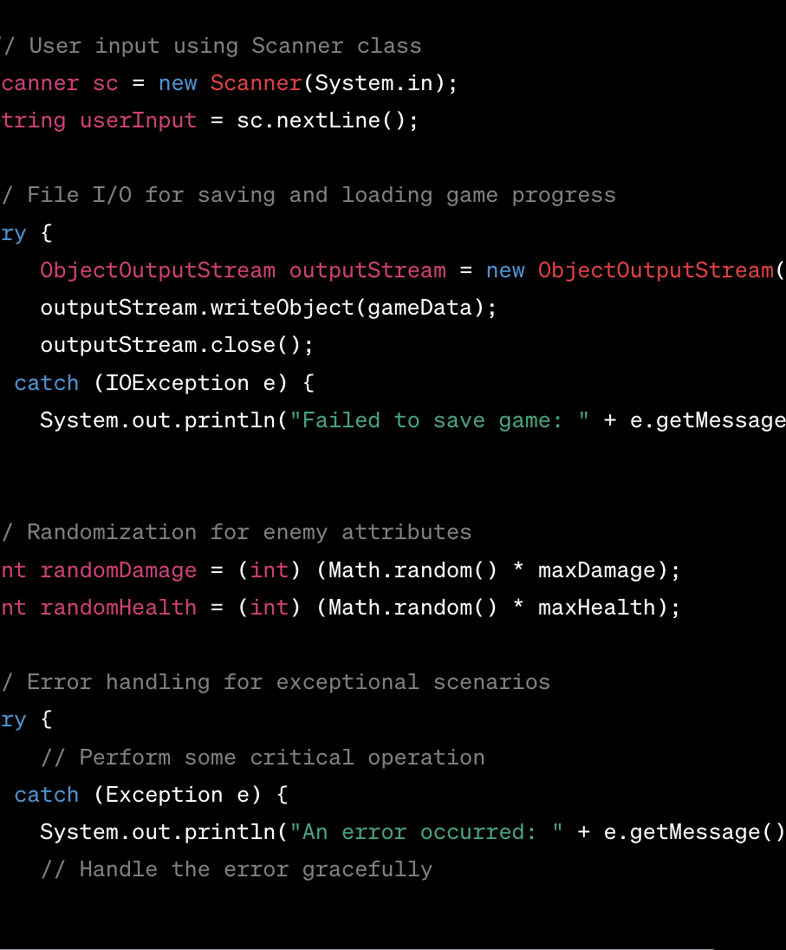
IMPLEMENTATION DETAILS
- Java programming language
- Object-oriented programming
- User input with Scanner class
- File I/O for saving and loading game - progress
- Randomization for enemy attributes
- Error handling mechanisms

Slide 7
TECHNICAL DETAILS
Technologies used:
Programming Language: Java
Development Environment: JDK
IDE: Eclipse, IntelliJ IDEA, or any Java IDE
System Requirements:
Java Runtime Environment (JRE) installed (version 8 or higher)
Adequate system resources (CPU, RAM) for running a Java application

Slide 8

INSTALLATION AND SETUP
- Install Java Runtime Environment (JRE)
- Download the Adventure Game source code
- Set up the project in a Java IDE
- Compile and run the Main class to start the game

Slide 9
FUTURE IMPROVEMENTS
- Additional locations and challenges
- Quests and side missions
- More weapons and armor options
- NPC(non-playable character) interactions and dialogue
- Include graphics and visuals
- Multiplayer functionality

Slide 10
CONCLUSION
- The Adventure Game offers an exciting and immersive gaming experience.
- Players can explore various locations, battle enemies, and purchase items.
- The ability to save and load game progress ensures a seamless gaming experience.
- The game's architecture leverages object-oriented principles for flexibility and extensibility.
- Overall, the Adventure Game provides an enjoyable adventure for players to who enjoy text base game.

Slide 11

REFERENCES
- Google: https://www.google.com/
- Youtube: https://www.youtube.com/
- Oracle Java Tutorials: https://docs.oracle.com/javase/tutorial/
- Stack Overflow: https://stackoverflow.com/
- GeeksforGeeks: https://www.geeksforgeeks.org/java/

